Slide 1
MOBILE APPLICATION DEVELOPMENT

Slide 2
“If we want users to like our software, we should design it to behave like a likeable person: respectful, generous and helpful.”
— Alan Cooper, software designer and programmer

Slide 3
“User experience encompasses all aspects of the end-user’s interaction with the company, its services, and its products.”
- Don Norman, a cognitive scientist and co-founder of the Nielsen Norman Group Design Consultancy

Slide 4
User Experience Design
User experience design (UXD or UED) is the process of enhancing customer satisfaction and loyalty by improving the usability, ease of use, and pleasure provided in the interaction between the customer and the product.
As UI Design is closer to what we refer to as graphic design, UX Design is a more analytical and technical field
    Content Courtesy: Careerfoundry.com

Slide 5
User Experience Design
User Experience Design is the process of development and improvement of quality interaction between a user and all facets of a company.
User Experience Design is responsible for being hands on with the process of research, testing, development, content, and prototyping to test for quality results.
User Experience Design is in theory a non-digital (cognitive science) practice, but used and defined predominantly by digital industries.
It actually converts business need to user need.
    Content Courtesy: Careerfoundry.com

Slide 6
User Experience Design
User experience (UX) focuses
  Deep understanding of users
    What they need
    What they value
    User abilities
    User limitations
  Business Goals
  Project Management Team Objectives

Slide 7
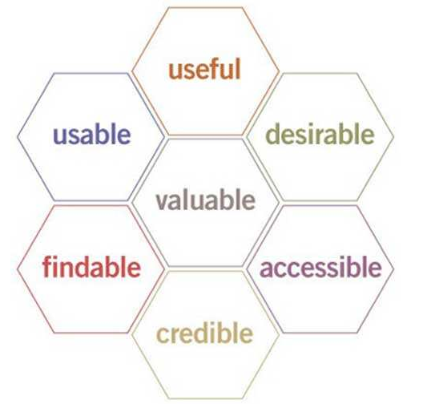
Factors Influencing UX
According to Peter Morville In order to get a meaningful and valuable user experience, information UX must be:
Useful: Your content should be original and fulfill a need
Usable: Site must be easy to use
Desirable: Image, identity, brand, and other design elements are used to evoke emotion and appreciation
Findable: Content needs to be navigable and locatable onsite and offsite
Accessible: Content needs to be accessible to people with disabilities
Credible: Users must trust and believe what you tell them
User Experience Honeycomb

Slide 8
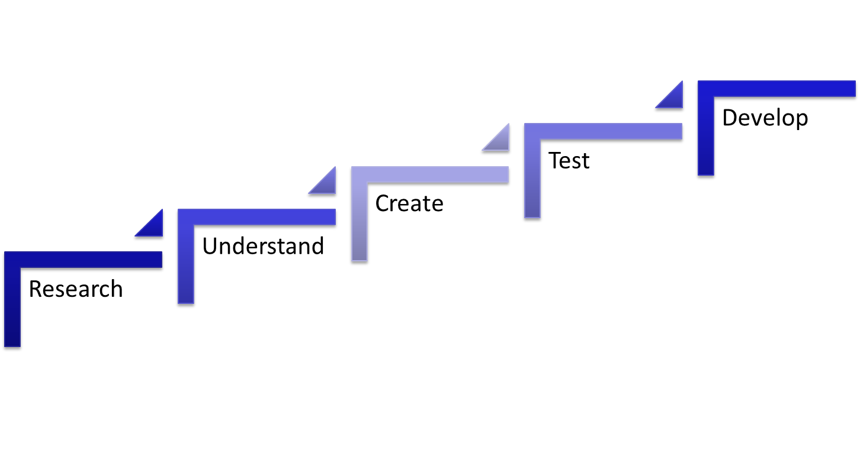
UX Design Process

Slide 9
UX Design Process
Research
  Meet the User
    User Demographics
    Define User Goal
    Define User Challenges
    Define metrics and form Hypothesis
Understand
  Be the User
    User Persona
    User Scenarios
    User Testing
    User Experience Map
Create
  Make it Simple
    Wireframe
    Mood boards
    Mockups
    Style Guide
Test
  Data Don’t lie
    Usability Tests
    Review Metrics
    Track Usage
    Inform Next Iteration
Develop
  STICK TO THE DESIGN

Slide 10
User Interface
  User interfaces are the access points where users interact with designs.
  User interface design is a craft that involves building an essential part of the user experience.
  Users are very swift to judge designs on usability and likeability.
  Designers focus on building interfaces users will find highly usable and efficient.
  Intangible nature of software: An illusion that users aren’t interacting with a device so much, make it more effortless.
  Facebook’s easy-to-use layout affords instant brand recognition
    Content Courtesy: The Interaction Design Foundation

Slide 11
DESIGN UIs
FOR
USER DELIGHT

Slide 12
User Interface Design
  It is the process of making interfaces in software or computerized devices with a FOCUS on looks or style.
  Designers aim to create designs users will find easy to use and pleasurable.
  UI design typically refers to graphical user interfaces but also includes others, such as voice-controlled ones.
  Content Courtesy: The Interaction Design Foundation

Slide 13
User Interface Design
  Basic Principles:
  ASK
    What user is going to do?
    What is he looking for?
      E.g. He is looking for some information or he is going to fill in a form etc.
  THINK
    What type of comparisons are they going to make, are they going to scan something or search it or what order would they follow?
  DESIGN
    The design must reveal the underlying principles or purposes it is about.
    The form follow function
    Content Courtesy: The Interaction Design Foundation

Slide 14
How to make great GUIs?
Users are humans
  Provide them comfort and low cognitive loads.
    Make elements (User Interface Elements) such as buttons perform predictably (including responses such as pinch = zoom)
    Form should follow function
    Maintain high discoverability.
    Clearly label icons
    Keep interfaces simple and create an invisible feel
    Every element must serve a purpose.
    Respect the user’s eye and attention regarding layout
    Focus on hierarchy and readability
    Draw attention to key features using color, brightness and contrast. Avoid excess!
    Content Courtesy: The Interaction Design Foundation

Slide 15
How to make great GUIs?
Users are humans
  Provide them comfort and low cognitive loads.
    Text via font sizes, bold type/weighting, italics, capitals and distance between letters. Users should pick up meanings just by scanning
    Focus on one chief function per page; guide users by indicating preferred actions
    Ease complex tasks by using progressive disclosure
    Put controls near objects users want to control
    Keep users informed vis-à-vis system responses/actions with feedback
    Consider defaults to reduce user burdens (e.g., pre-fill forms)
    Use reusable design patterns to guide behavior regarding navigation and search functions
    Concentrate on maintaining brand consistency
    Content Courtesy: The Interaction Design Foundation

Slide 16
User Interface Design
  Designing of Screen:
  Grouping of the items
  Order of the items
  Decorative items like fonts, colors, styles, boxes etc.
  Alignment of the items
  White spaces between the items
    Content Courtesy: The Interaction Design Foundation

Slide 17
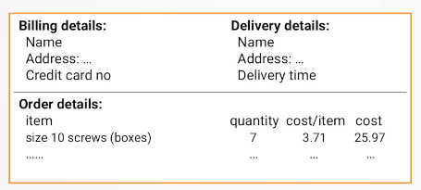
User Interface Design
  Designing of Screen:
  Grouping and Structure
    Are the items logically belong together?
      They should be physically together on the screen
    THE PHYSICAL STRUCTURE ON THE SCREEN REFLECT THE LOGICAL STRUCTURE
    Content Courtesy: The Interaction Design Foundation

Slide 18
User Interface Design
  Designing of Screen:
  Order of the Groups and items
    THINK!
      What is the Natural Order?
      Should match the screen order
        Use boxes and spaces etc.
        Use the tabbing right
        For example data filling app
      Instructions should be clear
      For example: cake mixing recipe says “..mix flour and milk, add the fruit after mixing.” What will happen if “after mixing” is on next page.
    Content Courtesy: The Interaction Design Foundation

Slide 19
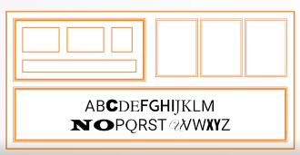
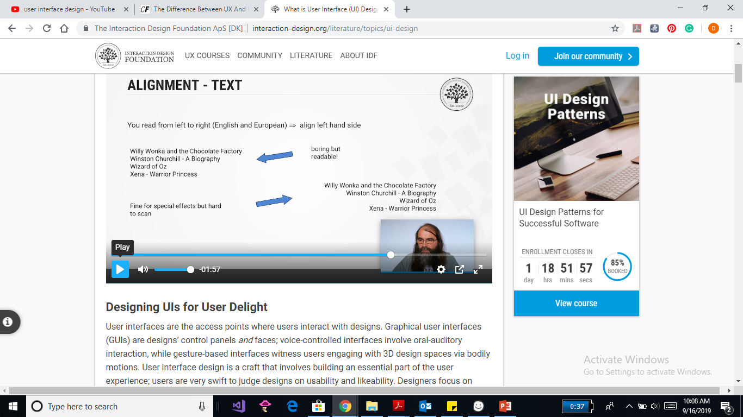
User Interface Design
  Designing of Screen:
  Decoration
    Use boxes to group logical items
    Use fonts for emphasis, headings etc.
    But do not use many.
  DONOT OVERDO!
  CHECK
    Functional Reasons
    Feasibility Reasons
  TEXT ALIGNMENT: left to right (mostly)
    Align the text to the left
    Content Courtesy: The Interaction Design Foundation

Slide 20
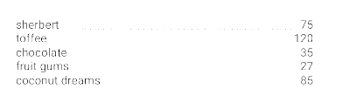
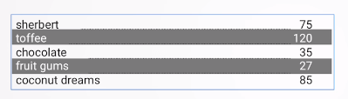
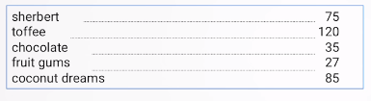
User Interface Design
  Designing of Screen:
  Decoration
    Multiple Columns
    Scanning across the gaps is hard (often harder to see with larger data base items)
    USE LEADERS (lead your eye across the page)
    Other ways (greying vertical)
    Content Courtesy: The Interaction Design Foundation

Slide 21
Which comes first?
UI is tangible
UX is intangible.
UI transforms ideas into realities
UX is the brainstorming
UX first, then UI

Slide 22
At the end!
THE BEST INTERFACE
IS
NO INTERFACE
Ask yourself:
Can I make things more simpler?

